Slide 1
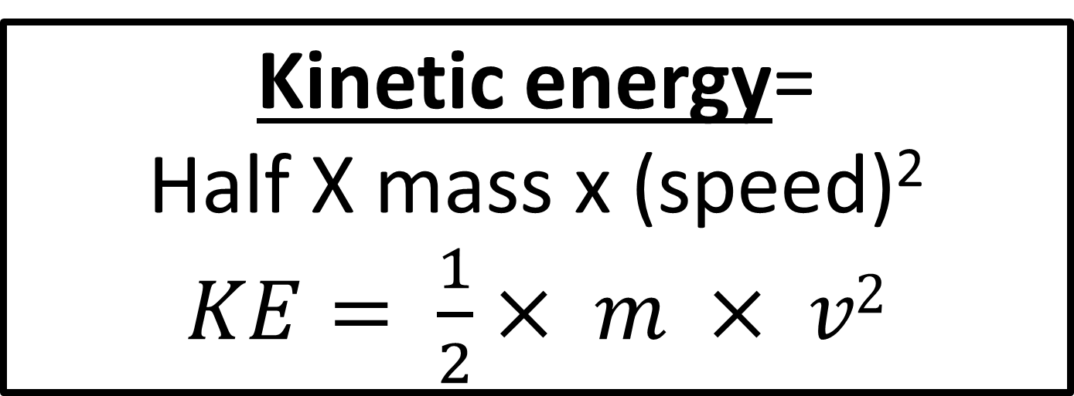
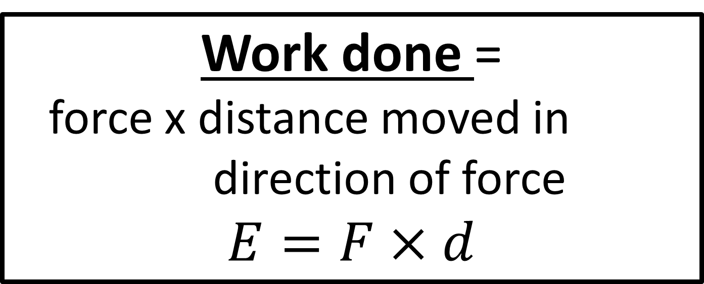
Work done =
force x distance moved in direction of force
$$E=F×d$$
Kinetic energy=
Half X mass x (speed)²
$KE= \frac{1}{2}× m × v2$

Slide 2
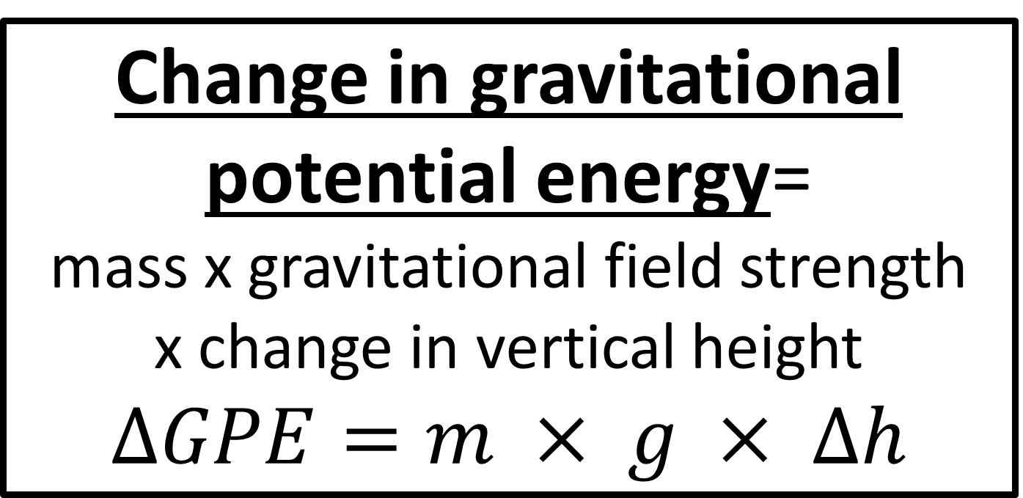
Change in gravitational potential energy=
mass x gravitational field strength
x change in vertical height
$∆GPE=m × g × ∆h$

Slide 3
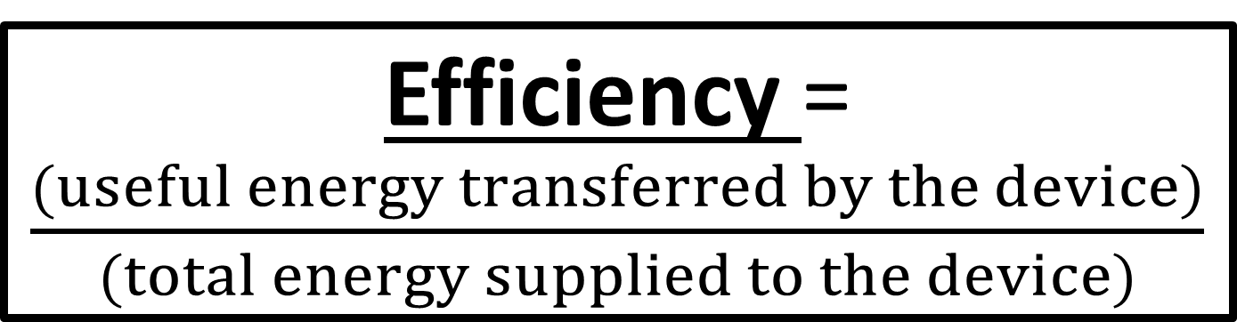
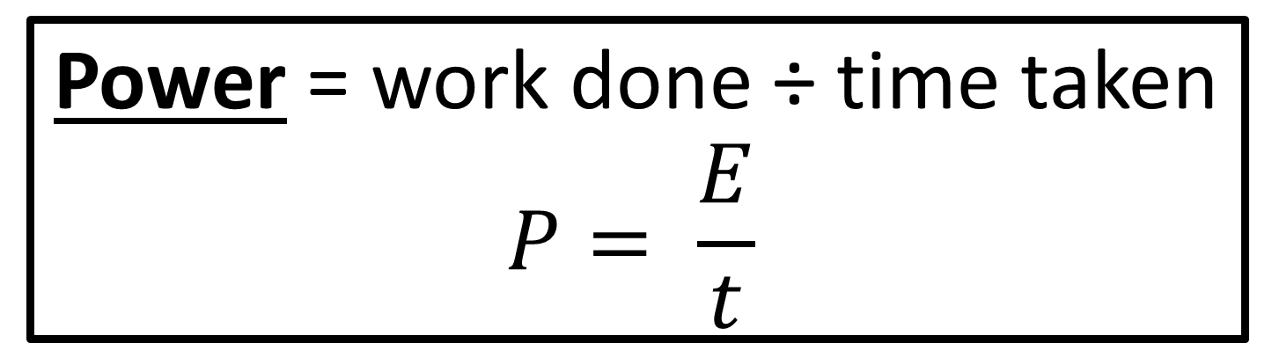
Power = work done ÷ time taken
$$P= \frac{E}{t}$$
Efficiency = $\frac{(useful energy transferred by the device)}{(total energy supplied to the device)}$

Slide 4
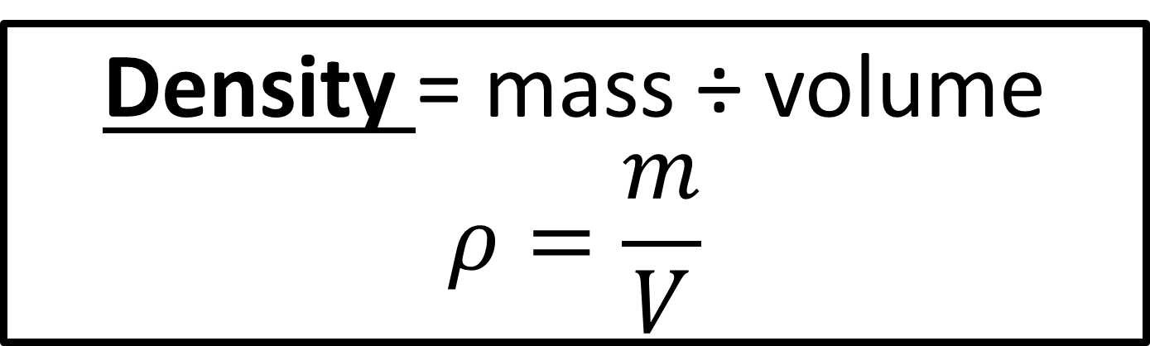
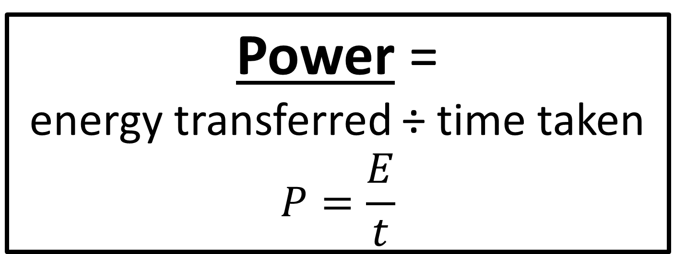
Power =
energy transferred ÷ time taken
$$P=\frac{E}{t}$$
Density = mass ÷ volume
$$ρ=\frac{m}{V}$$

Slide 5
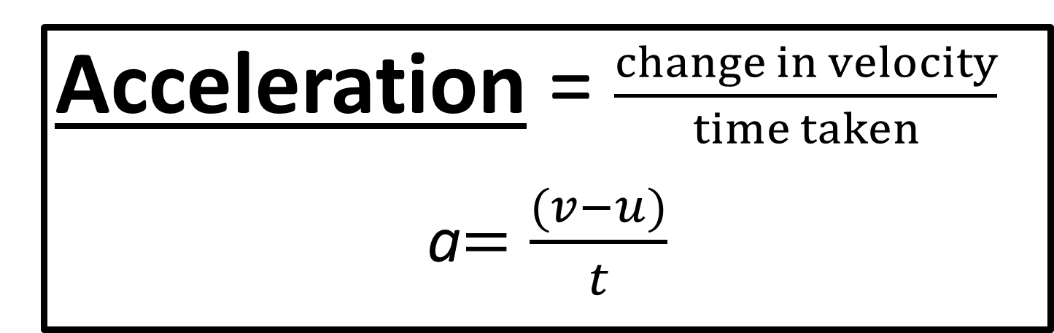
Distance travelled= average speed x time
Acceleration = $\frac{change in velocity}{time taken}$
a$=\frac{(v−u)}{t}$

Slide 6
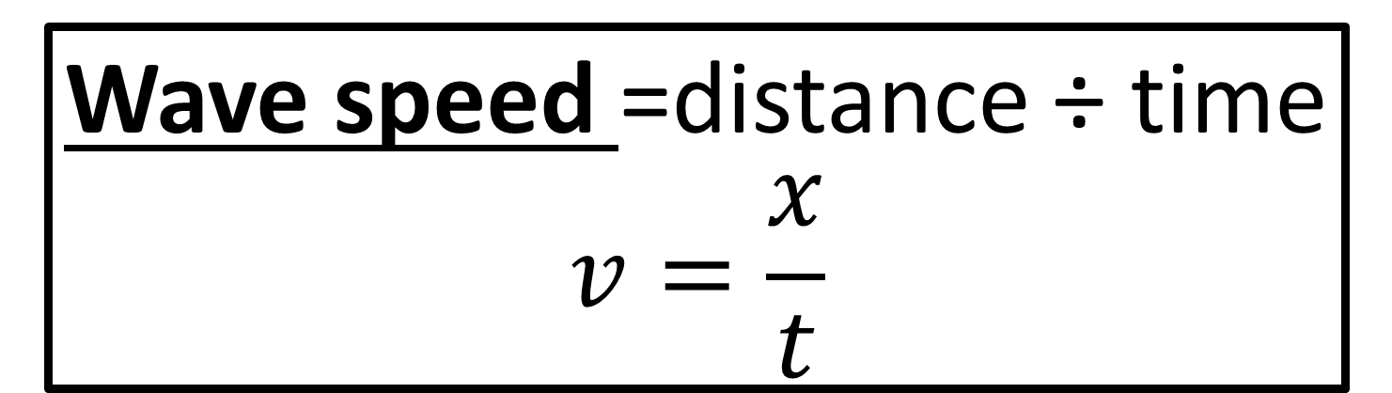
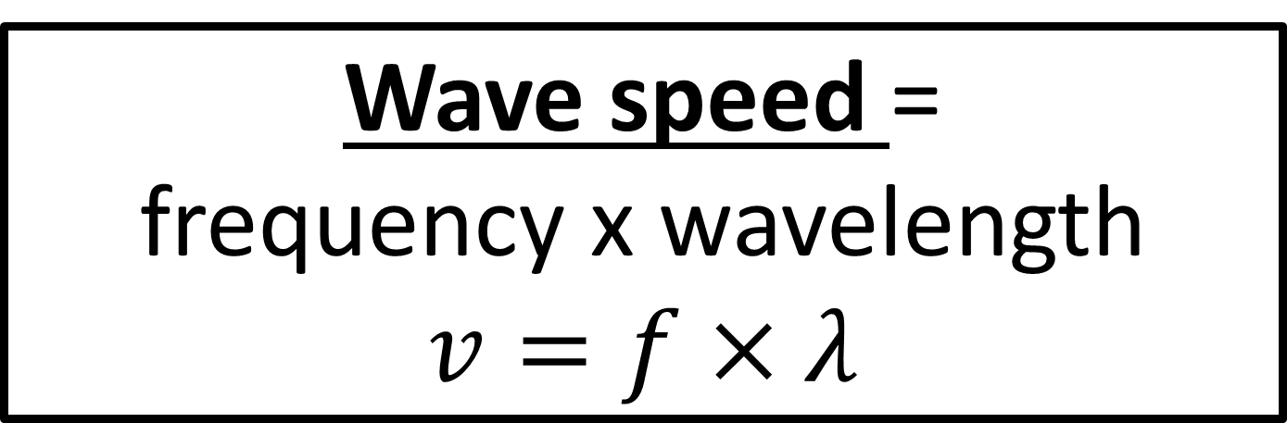
Wave speed =
frequency x wavelength
$$v=f×λ$$
Wave speed =distance ÷ time
$$v=\frac{x}{t}$$

Slide 7

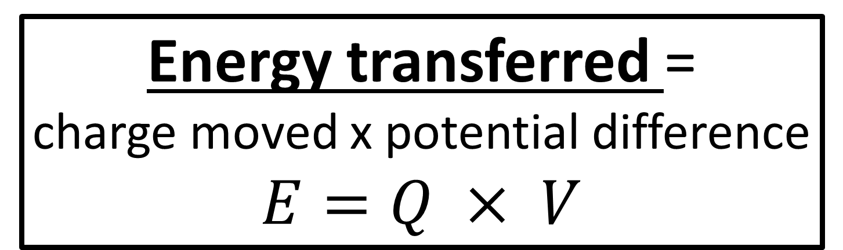
Energy transferred =
charge moved x potential difference
$E=Q × V$
Charge = current x time
$$Q=I×t$$

Slide 8
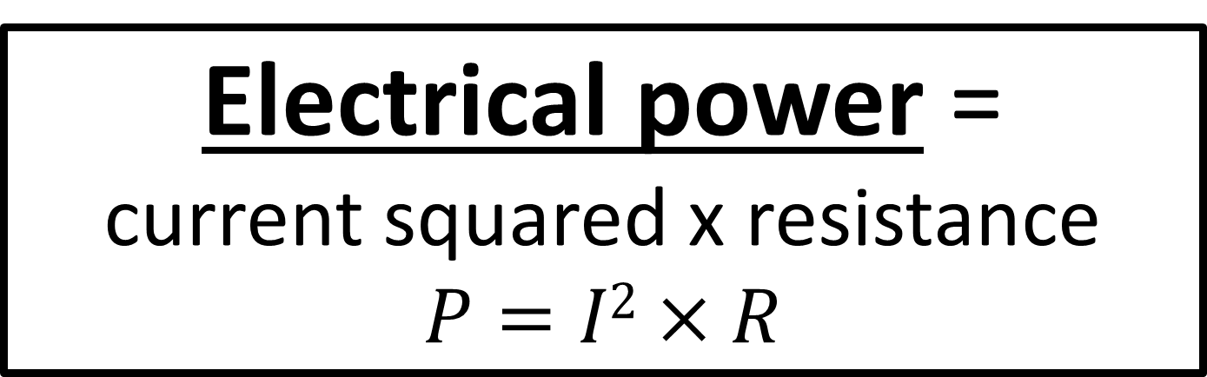
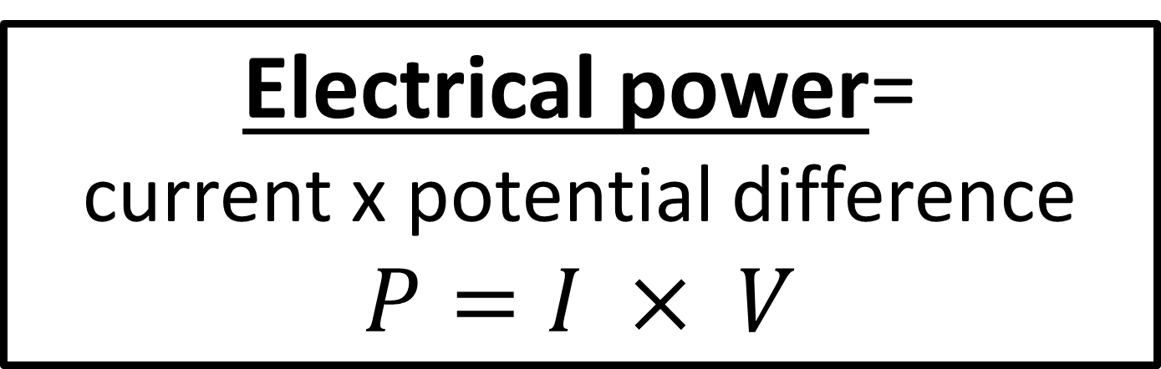
Electrical power=
current x potential difference
$P=I × V$
Electrical power =
current squared x resistance
$$P=I2×R$$

Slide 9
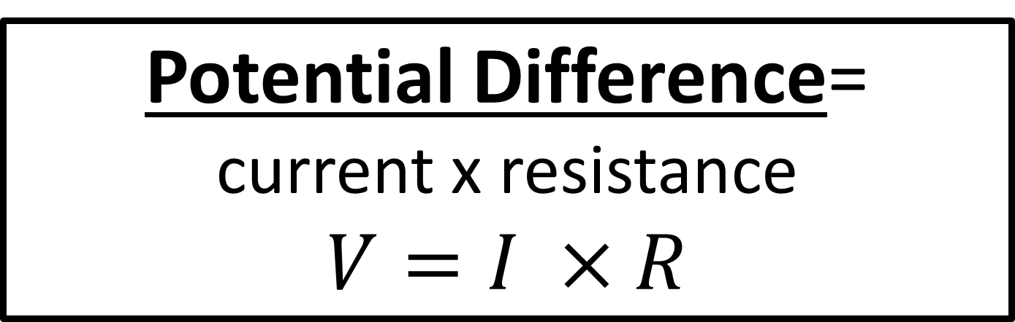
Potential Difference=
current x resistance
$V=I ×R$

Slide 10
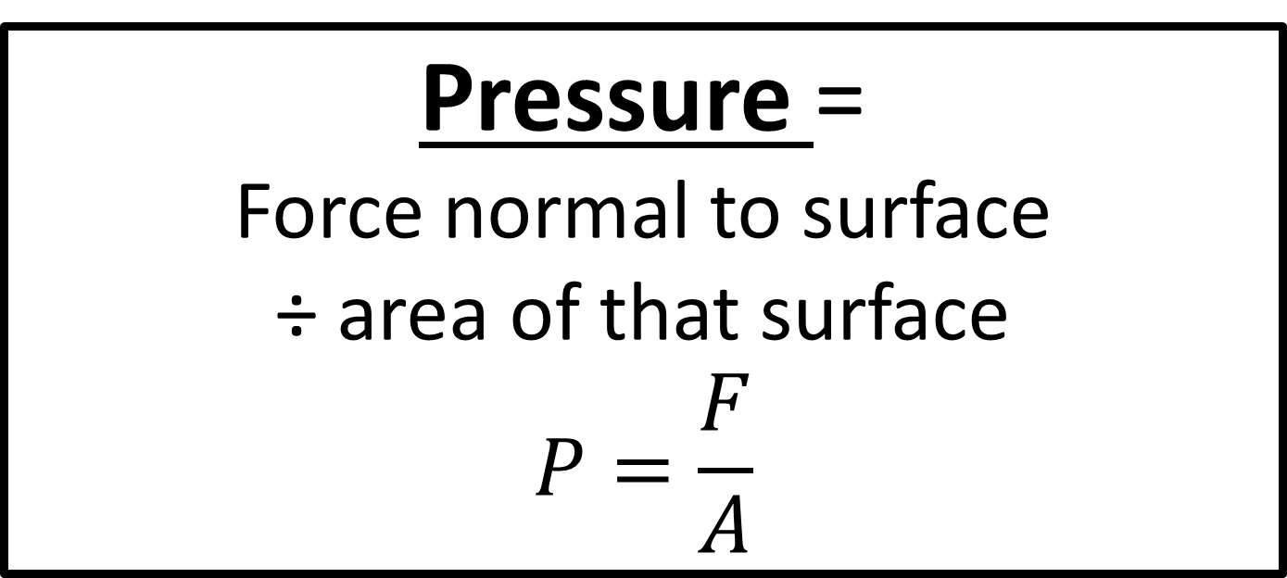
Moment of a force =
force x distance normal to
the direction of the force
Separates only
Pressure =
Force normal to surface
÷ area of that surface
$$P=\frac{F}{A}$$
Separates only

Slide 11
Force= mass x acceleration
F= m x a
Weight =
mass x gravitational field strength
W= m x g

Slide 12
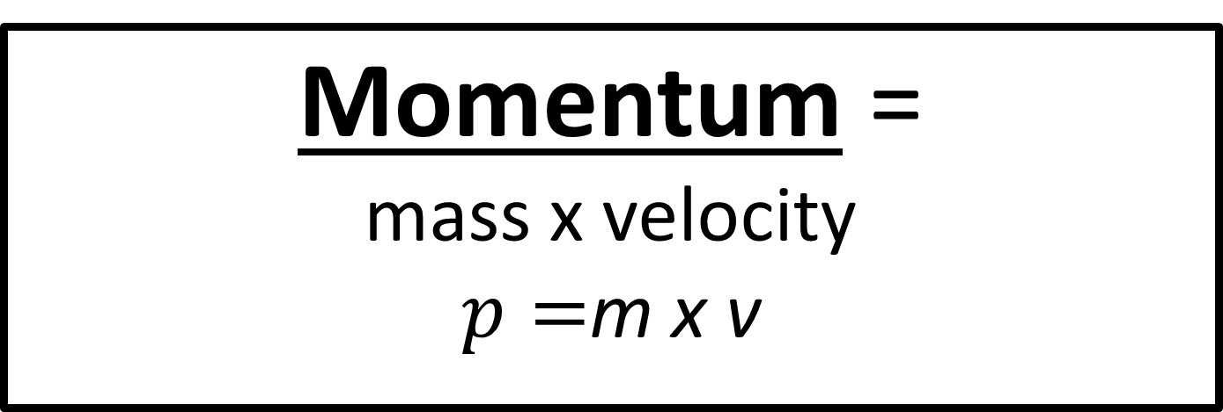
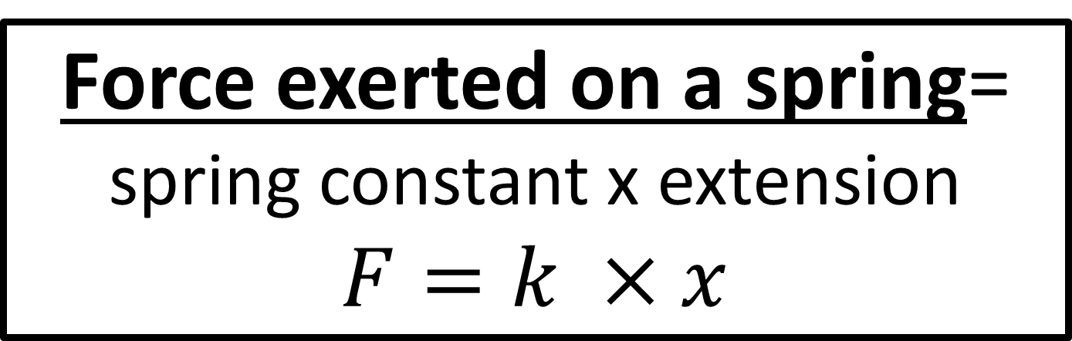
Force exerted on a spring=
spring constant x extension
$F=k ×x$
Momentum =
mass x velocity
$p=$m x v

